Slide 1


MA3831 Assignment 2
Financial News Sentiment Analysis using NLP
Hunter Kruger-Ilingworth 2025

Slide 2

The Inspiration
Stock trading is a large part of society
Trading styles: (Zucchi, 2025) (BarclayHedge, 2012)
Technical analysis
Fundamental analysis
Event/news driven trading
Past Literature has explored financial NLP sentiment analysis
Notes:
The stock market drives economic growth, allowing businesses to raise capital and investors to profit by buying low and selling high. As a result, trading and finance are large parts of modern society
There are a 2 main schools of thought when it comes to trading
- technical analysis, purely looking at the price over time and trading based on trend patterns, and
- fundamental analysis, which examines a company’s intrinsic value, assessing its people, its technology, and activities
News and consumer sentiment play a crucial role in predicting stock prices.
A fundamental analyst closely monitors financial news and social media to assess supply, demand, and market trends.
This requires constant tracking and interpretation of news, to make decision 24/7, inconvenient for those who enjoy sleeping or eating.
An investor would greatly benefit from an automated pipeline that:
Processes financial news in real-time,
Uses natural language processing (NLP) to analyse sentiment,
Identifies relevant entities and topics, and
Predicts potential stock price movements.
In this presentation, I will introduce an NLP-based solution for the Australian Stock Exchange (ASX) to streamline event-driven trading.
First, we will analyse some literature done in this space

Slide 3
Literature Overview
Paper Name, Authors, Year | Goal | Sentiment Data Source | Sentiment Analysis Method | Prediction Model Method
Kolasani, S.V. and Assaf, R. (2020) Predicting Stock Movement Using Sentiment Analysis of Twitter Feed with Neural Networks. Journal of Data Analysis and Information Processing, 8, 309-319. | predict the future movement of the United States’ stock market by analyzing the sentiment of Twitter posts related to the Stock market | Tweets containing keywords: "stock market," "stocktwits," "AAPL" | Support Vector Machines (SVM) trained on 1.6 million hand-labelled tweets from the Sentiment140 dataset | Multilayer Perceptron Neural Network (MLP)
MLP Neural Networks outperformed Boosted Regression Trees in terms of accuracy
Heaps of preprocessing required for tweets (improper grammar/spelling, emojis + lemmatization, stop word removal required
Overall Poor performance
Notes:
One such paper by Kolasani and colleagues used tweets as their corpus of text. They collected many tweets the contained financial keywords and compared a boosted regression tree with a multilayer perceptron neural network to make a model that predicts the daily price difference in that stock. It was evident that using tweets presented challenges, like the increased amount of text preprocessing required, since people use improper grammar online.

Slide 4
Literature Overview
Paper Name, Authors, Year | Goal | Sentiment Data Source | Sentiment Analysis Method | Prediction Model Method
Heiden, A., & Parpinell, R. S. (2021). Applying LSTM for stock price prediction with sentiment analysis. | Predict stock prices of the businesses in the Top 10 of the S&P 500 index | New York Times newspaper | Valence Aware Dictionary for Sentiment Reasoning (VADER) | Long Short-Term Memory (LSTM)
The VADER sentiment analysis model does not require a large database to achieve high accuracy
previous price is a crucial element to predict the price in the future, which is why LSTM was used
The results show clear superiority of the model using sentiments as a feature, having a better performance for all stocks analysed
Notes:
Another paper from Heiden and collegues, said that “Most of the attention has been given to social media platforms, while news from newspapers are not as widely explored in the literature.” they said that “Newspapers provide, although in a smaller volume, more reliable information than social media platforms.”
This study used VADER (Valence Aware Dictionary for Sentiment Reasoning) to analyse newspaper sentiment for select U.S. stocks as an input feature to a long short-term memory (LSTM) network, A type of recurrent neural network (RNN) that retains past stock market states for improved prediction. Results showed that including news sentiment significantly improved model performance.
Before we consider what the NLP solution will be able to do, we’ll first explore the potential sources of data we can use.

Slide 5
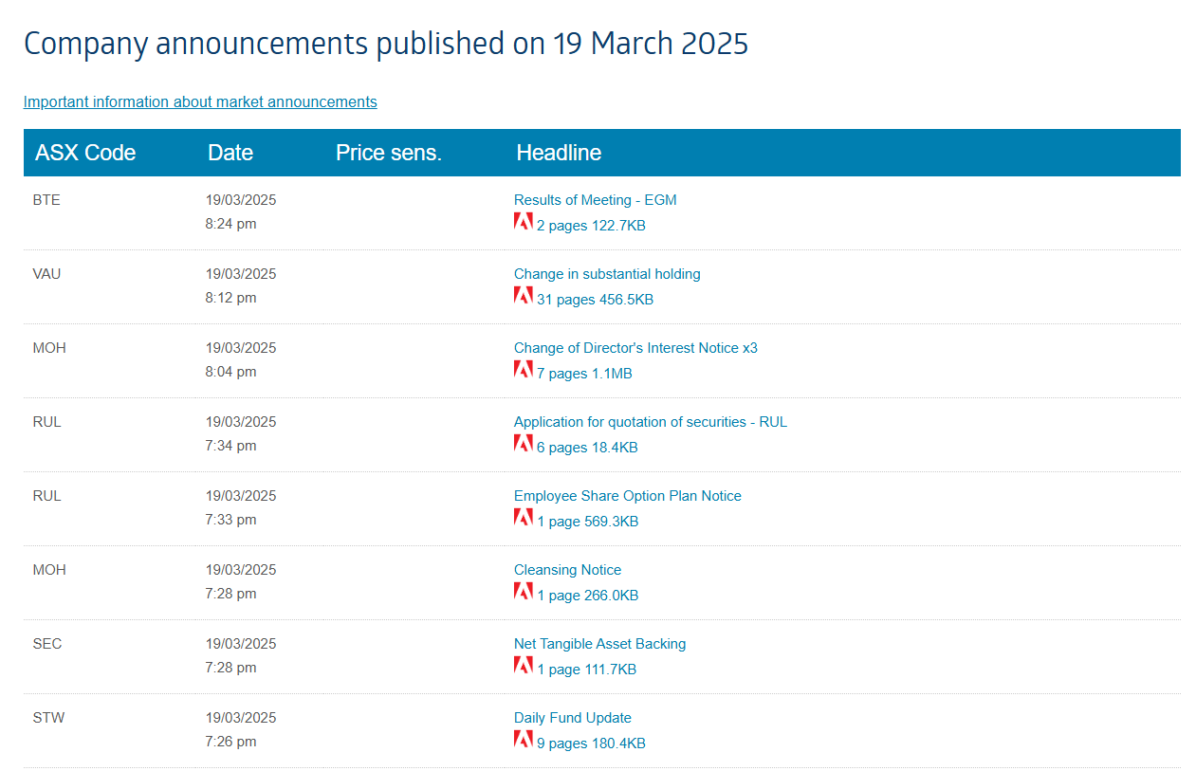
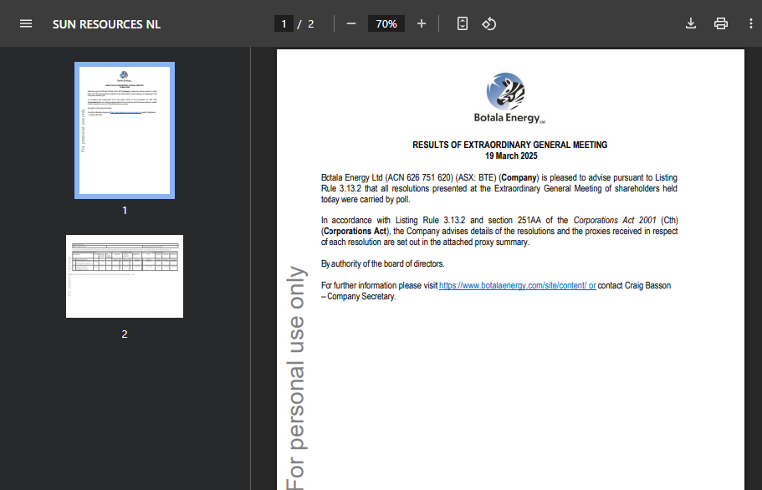


Potential Sources of Data
Asx announcements (Australian Securities Exchange, n.d.)
Are as objective as you can get, but really hard to interpret
Right at the source
Pdf format (not conducive for scraping)
Scraping announcements is in breach of the terms of service. No go.
Notes:
The first source of data considered was to use ASX market announcements, these are right from the source, and are highly frequent, but this wasn’t used as these often include mundane managerial changes that wouldn’t have much affect on the stock. its also against the terms of use of the asx to scrape these.

Slide 6
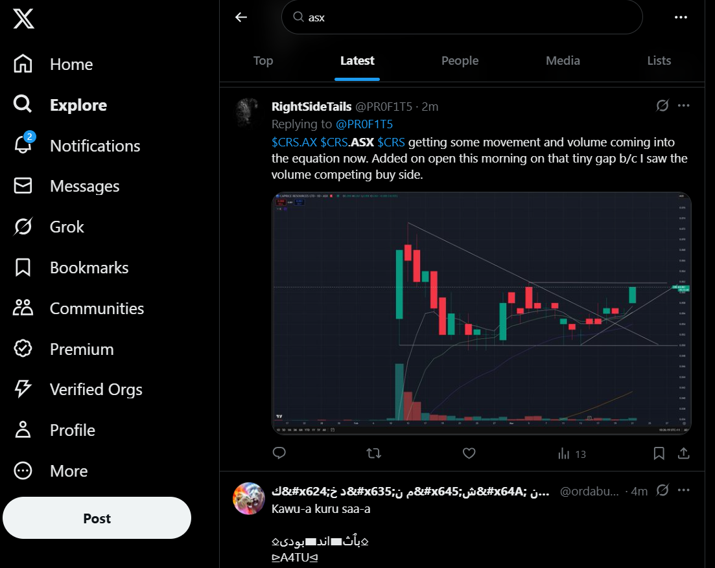
Potential Sources of Data
(X, 2025)
Social Media
Easy for users to post, so users can quickly react to news events
Less factual
Quantity of posts
More emotional, easier to gauge sentiment
Notes:
An alternative data source is social media platforms, which provide a high volume of real-time data. As the first study highlighted, however, processing unstructured text requires significant effort. Additionally, as the second study noted, social media content lacks reliability, as users are not obligated to provide factual or accurate information.

Slide 7
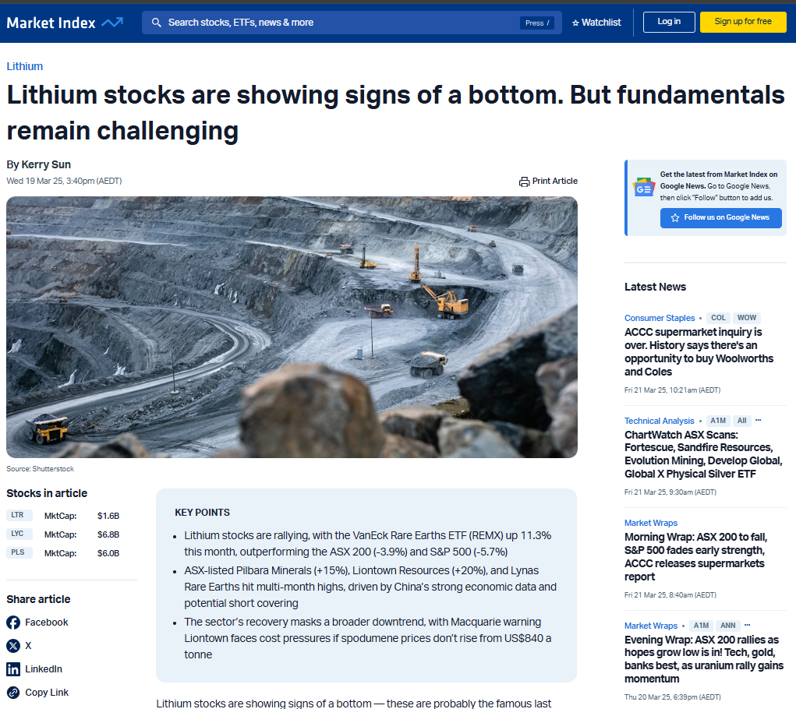
Potential Sources of Data
(Sun K, for Market Index, 2025)
Curated reports
Have more factual information (more reliable) (Heiden & Parpinell, 2021)
Medium Length ~ 500-1000 words
Less frequent than social media posts
Finance news sites generally dislike web scraping and automation
Notes:
In contrast, a financial news article site, it is more factual than using social media.
Additionally, these tend to be longer-form content, typically ranging in the 2000 word range. This would allow word embedding models like, perhaps, BERT to capture contextual nuances and extract deeper insights from the text. Furthermore, sometimes these websites provide helpful metadata like company tags, and industry tags that could be used as response variables to train a topic model, and a named entity recognition model.
It was ultimately decided to use financial news sites to get the corpus, acknowledging the following downsides: 1. Finance news sites are often cautious when it comes to web scraping and automation.
2. Curated reports take time to be written, edited, and published, making them less timely compared to social media updates.

Slide 8
Data Source Evaluation Criteria
Is scraping permitted in the terms of use (TOU)
Does the robots.txt file permit scraping of news articles
Does it use Cloudflare? http://www.doesitusecloudflare.com/
Data quality
Any useful data?
Is the website static?
Does it have a developer sitemap?
Australian copyright law under the ‘fair dealing’ exceptions Section 113P of the Copyright Act 1968 allows educational institutions to copy and communicate works for educational use (Copyright Act 1968, 2024)
Notes:
Listed here is the criteria that was used to choose which website or websites are suitable to scrape.
1. We first check if the terms of use permits scraping,
2. We then we consult the robots.txt file to verify that we can scrape articles from the website
3. We then consider if the website uses Cloudflare, which would prevent automated website navigation From there we make decisions on other things that the website provides, that may help either in the scraping process or the modelling process, for example the stock tags, or industry tags mentioned earlier
Newspaper articles are original works, and therefore fall under copyright. Our analysis is within the rules of copyright, as Australian copyright law has a category of exceptions known as ‘fair dealing’, which permits using copyrighted material for educational and research use.

Slide 9
Data Source Exploration
Website Name (URL hyperlinked) | Scraping Permitted in Terms of Use? | Allows Article Scraping in Robots.txt? | Uses Cloudflare? | Notes of quality
Market Index | No | Yes | No | Company tags on articles
Yahoo finance | No | No | No | NER required due to the lack of explicit article stock labelling. General politics also included which is difficult to relate to individual stocks
Trading Economics | Yes | Yes | No | General politics and economics also included – would require filtering (unstructured)
Financial Review | No | No | No
The Motley Fool | No | Yes | No
Syndey Morning Herald | No | No | No
Notes:
This table shows some of the websites that were considered

Slide 10
Data Source Exploration
Website Name (URL hyperlinked) | Scraping Permitted in Terms of Use? | Allows Article Scraping in Robots.txt? | Uses Cloudflare? | Notes of quality
The Market Online | No | Yes | No
ABC News | Yes | Yes | No | Regular news mixed with financial news, difficult to use, untagged stock market
Small Caps | Yes | Yes | No | Sitemap highly conducive to make scraping easier. Stock codes provided in articles. All about stocks – no general politics. Static web content (can simply just use beautiful Soup)
Morning Star | No | Yes | No | No Sitemap Provided
Australian Stock Report | Yes | Yes | No | Unstructured in comparison to other article sites
Stock Head | Yes | Yes | No | Great sitemap but no list of stock codes in article
The Australian | No | No | No
Hot Copper | No | Yes | No
Notes:
And here is the continued list of websites that were considered
It was decided to use the small caps website for scraping, as it contained detailed stock tags for each article, opening up more options for the potential NLP solution, and as ill demonstrate, is highly conducive to scraping due to providing a detailed developer sitemap, and also having no javascript or dynamic content that would otherwise get in the way of scraping an article. Relying on a single webpage risks sampling bias by limiting perspectives to one source, reflecting the biases of a select group of authors, potentially skewing results and reducing the extensibility.

Slide 11
Required Web Scraping Tools
Is Selenium Required?
No Dynamic Content
Use of Sitemap means no interaction required to go through discrete pages of search results or clicking ‘Show More’ etc
Beautiful Soup
Static content
Use the lxml parser for fast performance
Can scrape xml
Can scrape html
Notes:
For web scraping, in this case, Selenium isn’t needed since there’s no dynamic content—using the sitemap allows direct access to pages without interaction. Instead, Beautiful Soup is ideal for parsing static content, and the lxml parser ensures fast processing for both HTML and XML data

Slide 12
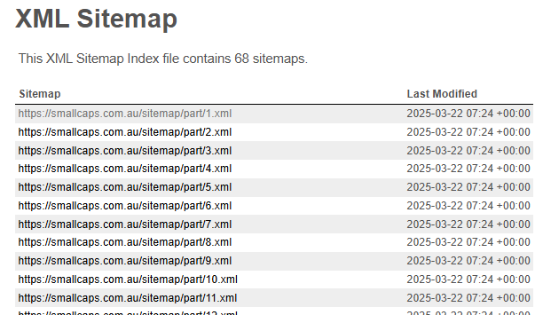
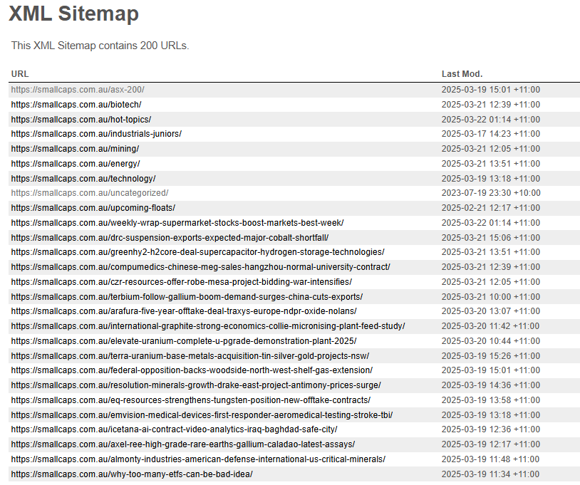


Sitemap xml parser
https://smallcaps.com.au/sitemap.xml
https://smallcaps.com.au/sitemap/part/1.xml
“topic” Pages.
Needs to be filtered
Notes:
Shown here is the sitemap of the smallcaps website, on the left is a sitemap of sitemaps (which there are 66 of), and on the right is drilling in, where it reveals individual articles (most of the time) - you can see on the right, that past some filtering, we have a nice list of article urls which we can then scrape
- You can see that each URL has a lost modified date, which gives a rough idea of when the article is dated without having to scrape it. An xml parser was created to collect all the metadata, and some exploratory data analysis was carried out

Slide 13
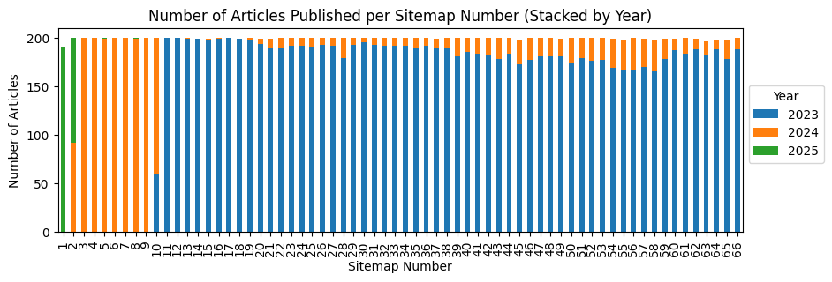
Notes:
You can see from this plot that there are about
200 articles per sitemap
And that the last modified date never goes back before 2023, which is strange
Looking further into this sitemap data…

Slide 14
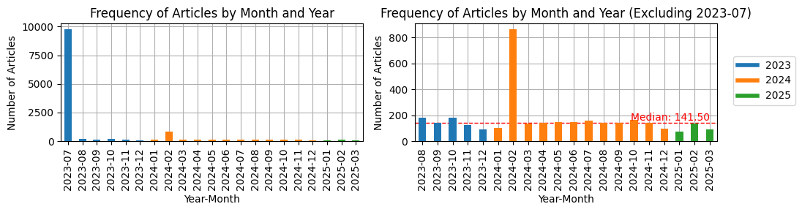


Total articles: 13,166
Notes:
Reveals that in July of 2023 all of the sites articles were modified, maybe because of some kind of site restructure,
- We still see that, if the modified date is anything to go by, that there are about 150 articles per month, indicating there is plenty of data to carry out this NLP solution

Slide 15
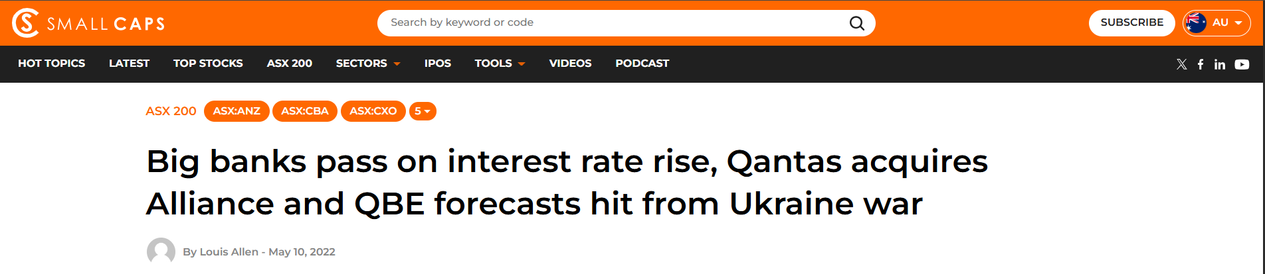
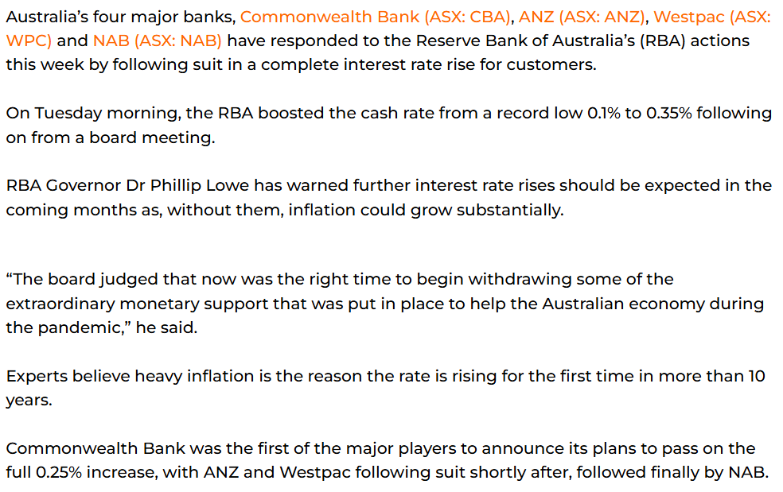
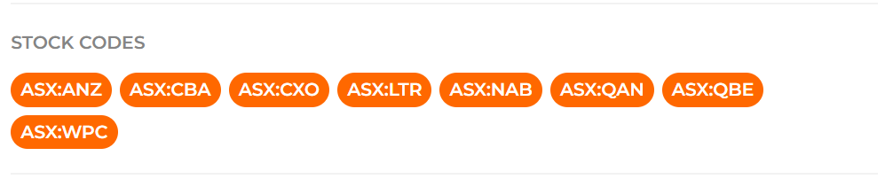
c-post__navigation-link
c-post-header__title
- c-post-header__author-link
- time
{'title': 'Big banks pass on interest rate rise...’,
'author': 'Louis Allen',
'date_string': 'May 10, 2022',
'sector': 'ASX 200',
'stock_codes’:['ASX:ANZ',
'ASX:CBA',
'ASX:CXO',
'ASX:LTR',
'ASX:NAB',
'ASX:QAN',
'ASX:QBE',
'ASX:WPC'],
'document': 'Australia’s four major banks...’}
c-rich-text c-post__rich-text
c-tags__text, iterate through c-tags__inner
Notes:
Looking at one of these articles looks something like this, ive gone ahead and annotated the html tags that correspond to the content we would be aiming to collect, which can be seen on the right. Using Beautiful Soup, a preliminary random sample of 30 articles was extracted and analysed to explore the resulting corpus.

Slide 16
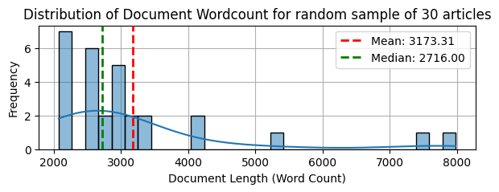
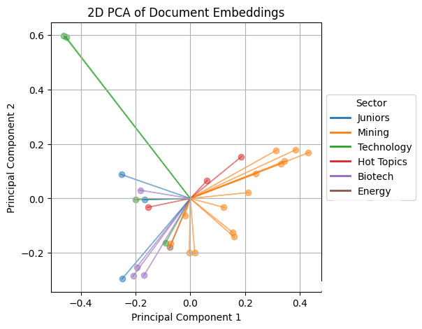
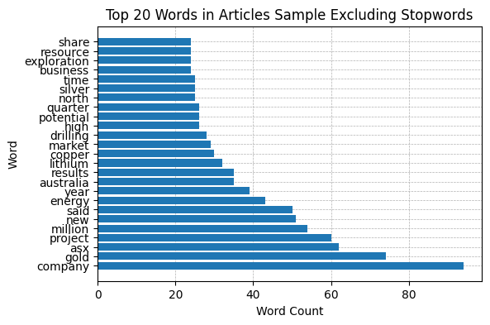
Article Sample Exploratory Data Analysis
Potential bias towards mining/energy in our random sample
Notes:
The top left plot shows the distribution of word counts for the sampled articles, all exceeding 2,000 words. This suggests that fewer articles may be required to train a model with sufficient data.
The bottom left plot highlights the most common words in the sample after removing stopwords. The dominance of terms related to mining and energy sectors indicates a potential bias in the dataset. Addressing this bias may require upsampling, downsampling, or weighting adjustments in any future model training.
The rightmost plot visualizes the documents in a numerical feature space using TF-IDF vectorization with PCA to explore their variance. The natural clustering of articles suggests that topic modeling could effectively differentiate sectors without relying on more complex word embedding techniques like BERT.

Slide 17
Proposed NLP Solution
1. Document Sentiment Analysis
Use VADER: No Training Data Required, Proven Generalisation (Heiden & Parpinell, 2021)
Can struggle with nuanced context unlike BERT Document Named Entity Recognition (Araci, 2019).
2. Named entity Recognition to associate sentiment with a stock or stocks (e.g. ASX:RIO, ASX:BHP)
There isn’t extensive literature on this topic
(Dolphin et al., 2024) used LLMs to achieve this
Libraries that have NER functionality (FlairNLP, 2019) (Explosion AI, 2018)
3. Document Topic Modelling/classification (mining, banking, energy)
Use a simple classification model to classify the ‘sector’ label that is provided
We’ve already scraped the class from the article
Could use unsupervised approach like LSA/LDA, but would be less interpretable, as we already have the desired labels – may be worth exploring though.
Out of scope:
- Stock market price prediction model
Notes:
Wrapping up, Now that we understand what data we have and the problem, I suggest the following proposal for NLP tasks to be done The first part is Sentiment Analysis
We need to determine whether a financial news article carries a positive or negative sentiment.
VADER is a good choice because it requires no training and has been shown to generalize well in financial contexts (Heiden & Parpinell, 2021).
However, it struggles with nuanced financial language, unlike transformer-based models like FinBERT, which better capture context (Araci, 2019).
The second part Named Entity Recognition (NER) for Stock Association
This requires an NER system that accurately detects codes and company names, referred to as tickers in some sources
Dolphin et al. (2024) used LLMs for this, whereas there are also Libraries like Flair and spaCy which provide off-the-shelf NER functionality The third part is Topic Modelling & Classification
The simplest and the preferred approach is a classification model, leveraging our sector labels that we have already scraped.
Alternatively, an unsupervised method like LDA or LSA could discover hidden themes, though it would be less interpretable and not adhere to these nice labels
This project does not focus on stock price prediction—we are purely extracting insights, linking sentiment to stocks, and categorizing news, though this would set a great groundwork for future modelling using each of these pieces as some kind of input feature This concludes my presentation. Thank you.

Slide 18
References
Zucchi, K. (2025, January 9). Fundamental vs. Technical Analysis. Investopedia. https://www.investopedia.com/articles/investing/040216/fundamental-vs-technical-analysis.asp
BarclayHedge. (2012, February 2). Understanding event-driven investing. https://www.barclayhedge.com/insider/hedge-fund-strategy-event-driven
Australian Securities Exchange. (n.d.). Today's announcements. Retrieved from https://www.asx.com.au/markets/trade-our-cash-market/todays-announcements
X. (n.d.). Home page. Retrieved March 20, 2025, Retrieved from https://x.com
Sun, K. (2025, March 19). Lithium stocks are showing signs of a bottom, but fundamentals remain challenging. Market Index. https://www.marketindex.com.au/news/lithium-stocks-are-showing-signs-of-a-bottom-but-fundamentals-remain
Copyright Act 1968 (Cth). (2024). Compilation No. 64 (as amended on 11 December 2024). Australian Government. https://www.legislation.gov.au/Series/C1968A00063
Heiden, A., & Parpinell, R. S. (2021). Applying LSTM for stock price prediction with sentiment analysis. Proceedings of the 2021 Conference on Brazilian Computational Intelligence (CBIC). https://doi.org/10.21528/CBIC2021-45
Kolasani, S. V., & Assaf, R. (2020). Predicting stock movement using sentiment analysis of Twitter feed with neural networks. Journal of Data Analysis and Information Processing, 8(4), 309-319. https://doi.org/10.4236/jdaip.2020.84018
Dolphin, R., Dursun, J., Chow, J., Blankenship, J., Adams, K., & Pike, Q. (2024). Extracting structured insights from financial news: An augmented LLM-driven approach. arXiv preprint arXiv:2407.15788. https://arxiv.org/abs/2407.15788
FlairNLP. (2019). Flair: A framework for state-of-the-art NLP [Github Repository]. GitHub. Retrieved from https://github.com/flairNLP/flair
Explosion AI. (2018). spaCy: Industrial-strength natural language processing in Python [Github Repository]. GitHub. Retrieved from https://github.com/explosion/spaCy
Araci, D. (2019). FinBERT: Financial Sentiment Analysis with Pre-trained Language Models. arXiv preprint arXiv:1908.10063. DOI: 10.48550/arXiv.1908.10063

Slide 19
Sitemap XML web scraping code

Slide 20
Article Scraping Code

